Slide 1
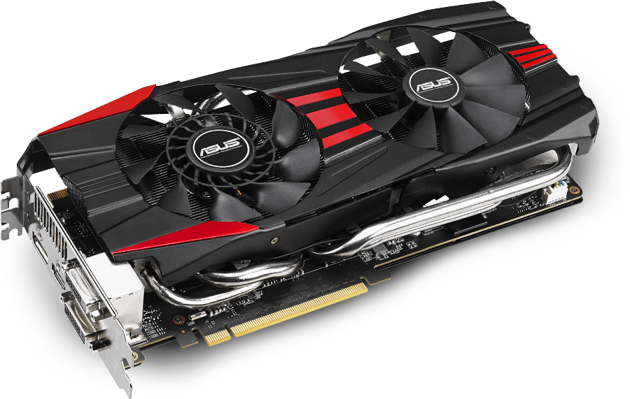
Graphics processing unit
Mansoor Hussian (19pwcse1858)
Abdul Raheem (19pwcse1789)
Amir Suliman (19pwcse1805)

Slide 2
Contents:
What is GPU?
GPUs vs. CPUs.
Types of GPUs.
What are GPUs Used For?
Conclusion.

Slide 3
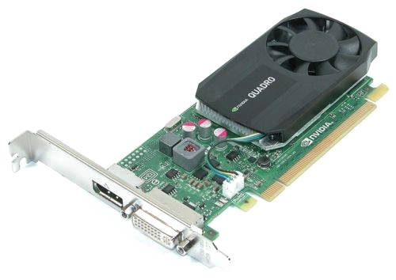
What is gpu?
A graphic processing unit (GPU) is a specialized processor originally designed to accelerate graphics rendering.

Slide 4


Cpu vs. gpu
CPU
CPUs have continued to deliver performance increases through architectural innovations, faster clock speed, and the addition of cores.
GPU
GPUs are specifically designed to accelerate computer graphics workloads.

Slide 5

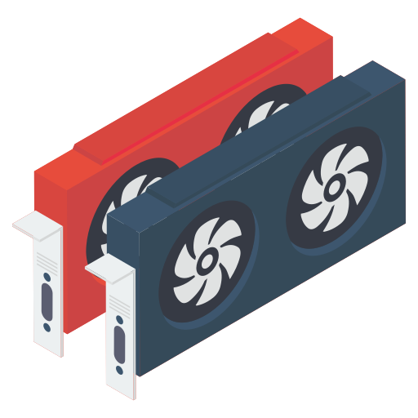
Types of GPU
Tow types:
Integrated –Embedded alongside CPU.
Benefits –small, energy-efficient, and less expensive.
Dedicated –A piece of hardware to manage the graphics performance of a computer.
Large energy consumption and heat creation. Requires dedicated cooling process for maximum performance.

Slide 6
Usage of gpu
Gaming.
Video editing and content creation.
Machine learning/Deep learning.
3D graphics rendering.

Slide 7
conclusion
GPU is a special processing unit designed for graphics workloads only.
GPU does no computing, just rendering graphics.

